Slide 1
The guidelines for creation a data model for encoding the Miklošič dictionary Old Slavonic – Greek / Latin Dictionary (Lexicon Palaeoslovenico – Graeco-Latinum)
Dr. sc. Martina Kramarić
Institute of Croatian Language and Linguistics

Slide 2
About me
an early-stage researcher at the Institute of Croatian Language and Linguistics
historical linguists and lexicographer
worked on the project Old Croatian Dictionary, currently on the project of digitization of old Croatians grammars and dictionaries

Slide 3
About dictionary
Lexicon Palaeoslovenico – Graeco-Latinum / Old Slavonic – Greek / Latin Dictionary
published in 1865 by F. Miklošič
the most relevant dictionary in diachronic Slavic studies
1,172 pages
42,000 words
phD thesis: Czech loanwords in Zrcalo člověčaskogo spasenja (1445) in the context of Old Croatian translations from the Old Czech language (2015)

Slide 4
About dictionary
Old Slavonic word meanings are given in Greek and Latin, and are compared with words from all European languages
etymology is provided
it takes into account written sources from all Slavic regions (in all Church Slavonic redactions and the canonical Old Church Slavonic language) from bettween 11th and 17th centuries.

Slide 5
About project
The project of digitization of Miklošič dictionary is developed in cooperation of the Belgrade Center for Digital Humanities and Institute of Serbian Language of the Serbian Arts and Sciences Academy for the dictionary platform Raskovnik.org. (http://raskovnik.org)

Slide 6
About project
Aim: to create a data model for encoding Miklošič dictionary in TEI
Challenges:
dictionary entries are not unified (short one, long one)
its structure is not clear
meanings are provides true translations (Greek and/or Latin)

Slide 7
About project
in some entries (not all of them) the bibliographical data are given with the examples of use
the examples of use can be given by quoting the collocations, phrases or sentences where the headword is used

Slide 8
About project
end of the entry provides parallels of the word in other Slavic, eventually Indo-European languages
different scripts are used.

Slide 9
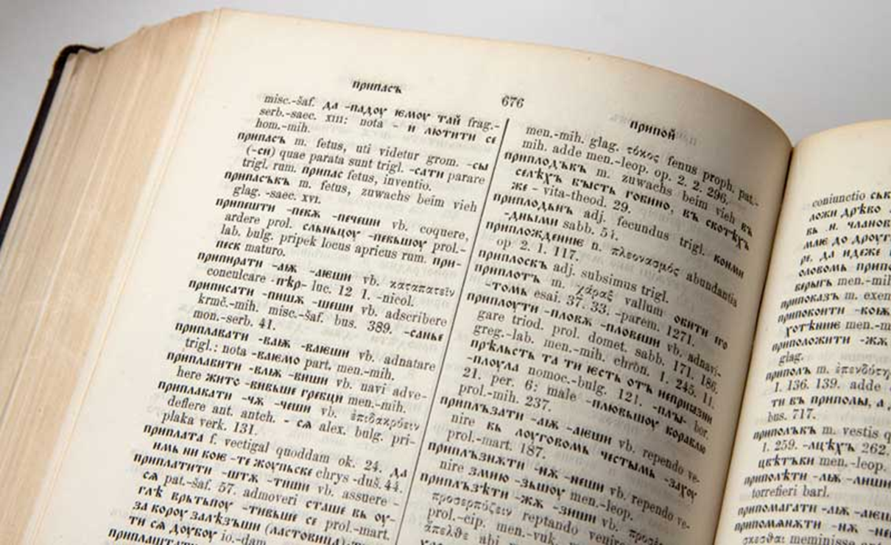
How to create a digital edition of such complex dictionary?
end of the entry provides parallels of the word in other Slavic, eventually Indo-European languages
Hungarian and Romanian words are also mentioned in some dictionary entries

Slide 10
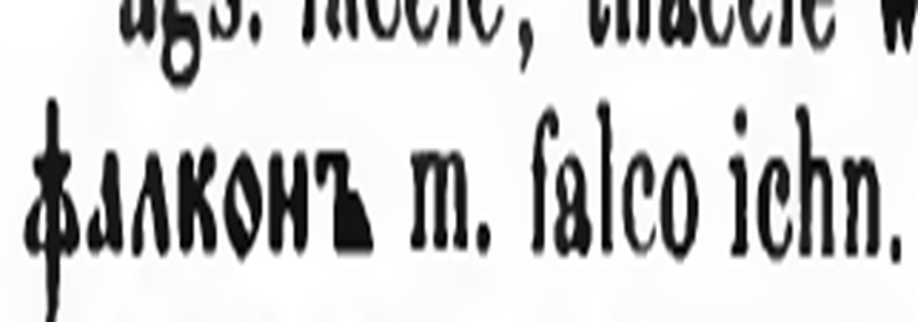
Simple dictionary entry

Slide 11
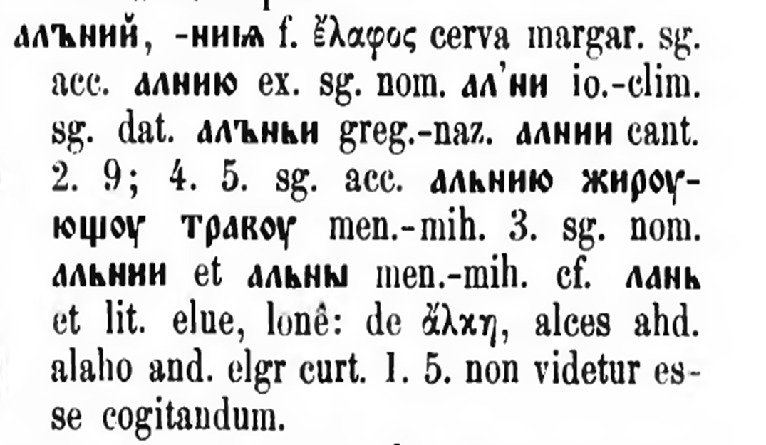
Complex dictionary entry

Slide 12
Guidelines
Idea is to create guidelines for data model in TEI:
unification and simplification of the dictionary entry
to extract the relevant data from each dictionary entry:

Slide 13
Guidelines
headword, definition, pos, example of use, parallel lemma, sources, etymology, cross refferences etc.

Slide 14
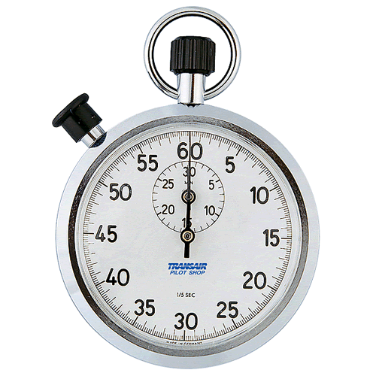
Time’s Up!
About your speaker:
  Name: Martina Kramarić
  Institution: Institute of Croatian Language and Linguistics
  Social Media: mkramar@ihjj.hr
  Quick bio: http://ihjj.hr/istrazivac/martina-kramaric/52/

